Slide 1
Anatomy of building AI Systems
Santosh GSK
Industry Expert

Slide 2
AI Systems
The motivation for building AI systems can be attributed to
Improving any existing processes, e.g., monitoring & alerting in healthcare
Reduce human effort, e.g., predicting new trends in stock market, identify prospective leads
Improve user experience, e.g., recommendations

Slide 3
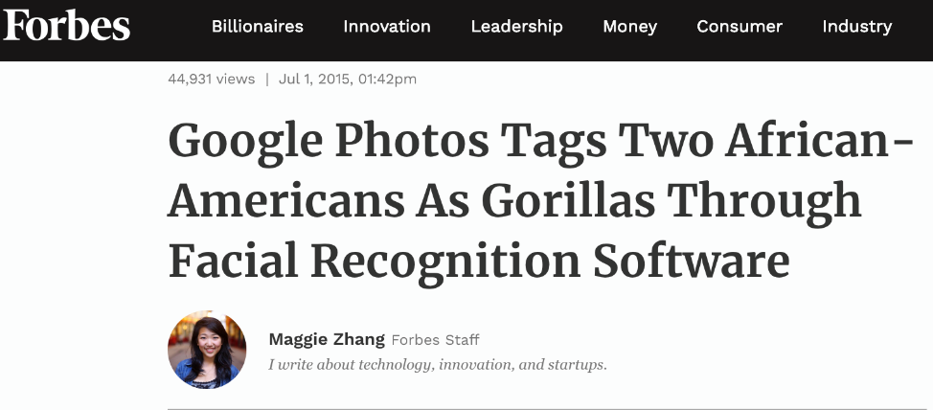

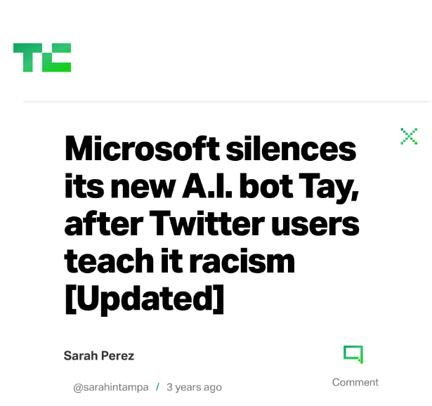


AI – Negative Impacts

Slide 4
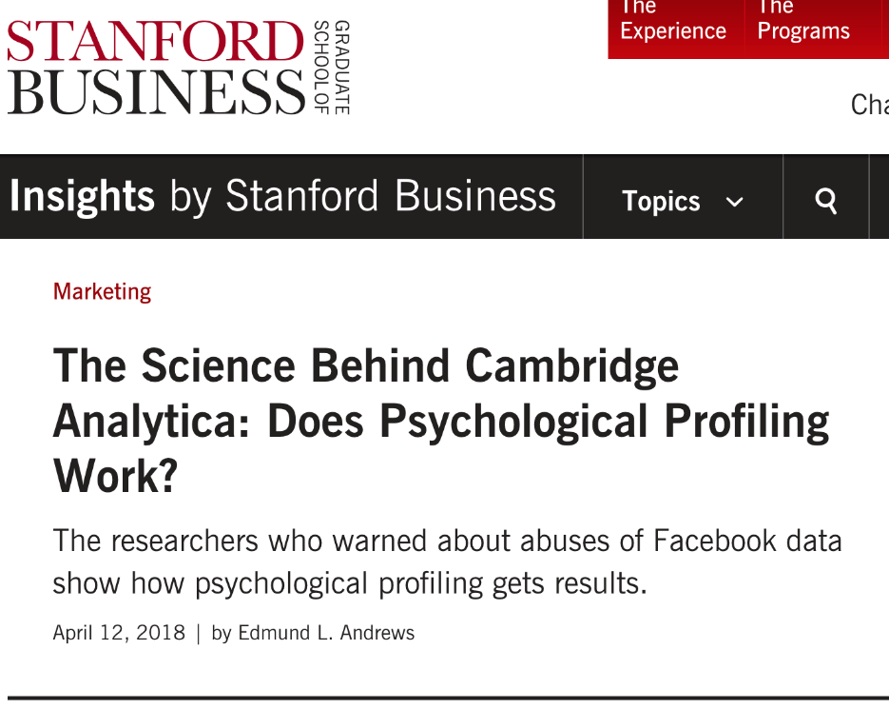
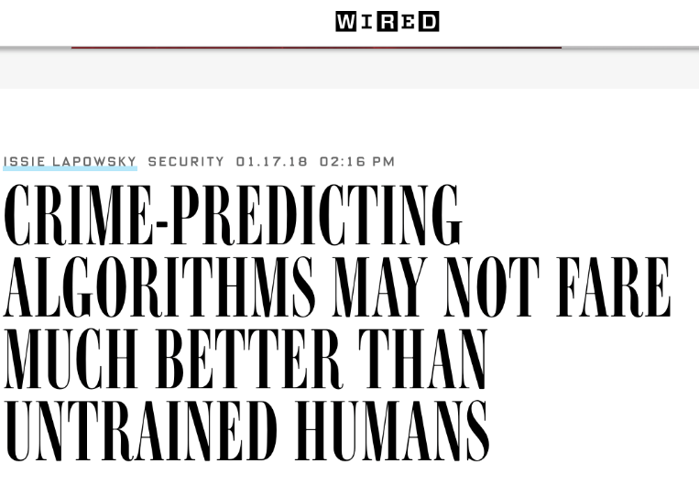
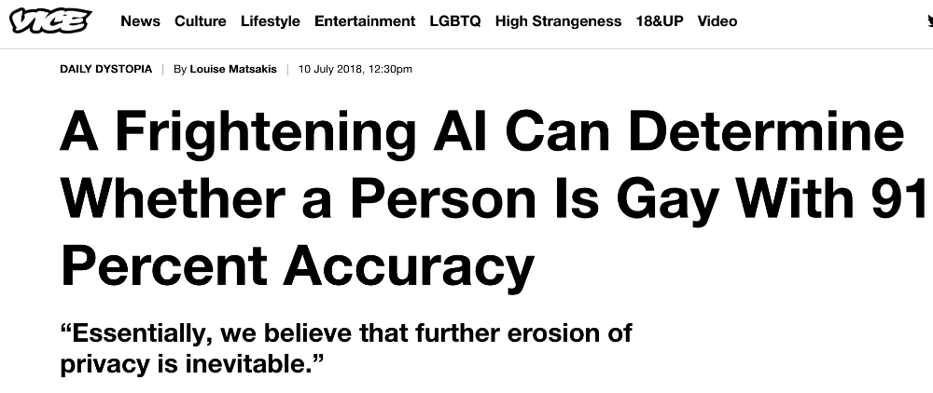
AI – Negative Impacts

Slide 5
AI Systems
Earlier AI was used to study about human societies
These models are now shaping human societies
They determine what kind of music/movies you interact with
They determine your political affiliation
They help you / hinder you in job applications
Also in loan applications
They determine what kind of treatment you might receive for health conditions
They even decide who you are likely to be dating
They already control your life

Slide 6
AI System
When AI is greatly shaping our world, are we sure that the predictions are fair and unbiased?
Given that top tech companies are failing to solve such problems
What guarantees the models built by small companies are fair to every sub-section of people?
We are now in an age of machine action where algorithms can benefit some individuals but may do so at the cost of harming others
Transitioning fragile and contentious matters of human judgment to trained models must be done with care and forethought
Anyone with a weekend training over Data Science are building models impacting their users
Every stakeholder should be involved in building the right model with the right impact

Slide 7
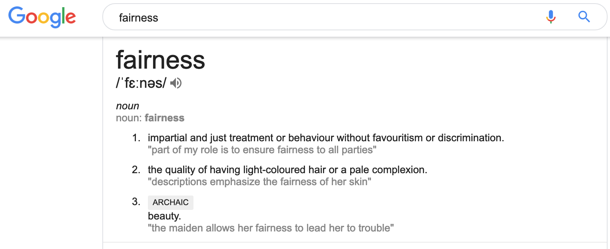
Fairness & AI

Slide 8
Defining Fairness
Determining what was right or fair was a privilege vested in certain authorities and the results were absolute, allowing for no disagreement.
This traditional view has changed as modern philosophy and ethics has revised our typological ways of thinking into a normative framing where concepts such as "fair" or "just" are no longer static;
Rather, they are developed relative to particular communities (who) and contexts (when/how)

Slide 9
Defining Fairness
Even if we would like to define ”fairness” for building ML models, it is contextual fairness that we can best describe
E.g., In cases where we need to identify the right medical diagnosis from radiology reports, we have consensus that it has to be accurate and work equally well for every person
However, determining whether an individual convicted of a crime might be a repeat offender is likely to solicit a lot of disagreement.

Slide 10
Defining Fairness
Proposition (P1): A machine learning system can only be fair with a contextual justification for the choice of a fairness construct and offering a channel for affected parties to actively assent or dissent to the fairness of the system.
Fairness Construct – what fair means in the given problem space and approach used to codify and measure that construct in training and application
The proposition dictates that
The team implementing the ML system should have viewpoints around fairness in the problem domain and be prepared to explain their choices
Some mode of disagreement should be allowed – creating an algorithmic process where fairness can be scrutinized or working with active community to address and resolve disputes

Slide 11
Contextual Fairness
Framework to consider to enquire fairness for an ML model
Is it fair to make X ML system?
I want to make a fair X ML system, is there a technical approach?
I made X ML system, are the results fair?

Slide 12
1. Is it fair to make X ML System?
“If we can, we ought to” is often treated as unstated premise for technological development
Given a normative definition of fairness, that questions of
whether any data could ever approximate certain problems
E.g., Musk, Wozniak and Hawking urge ban on warfare AI and autonomous weapons
Should we give engineers the authority to decide?
Who should be the likely authority then?
External review should be preferred
In fact, considering all the impact groups of this ML system and reviewing their concerns would help

Slide 13
I want to make X ML system. Any fair tech?
Three categories would answer this question
Interpretability or white-box models
This would approach fairness by developing training methods that aim to produce interpretable ML
Based on the interpretations, fairness can be judged
Developing statistical independence between predictions and protected categories
By robust sampling across groups
Minimizing the difference in misclassification rates across groups
Training models where protected variables are neither explicitly or latently used
Decision-making algorithms that attempt to construct fair metrics for optimal choices
These attempts start with the adoption of a quality function that evaluates decisions and
then argue for differing approaches toward optimizing choices such as always making choices that minimize regret

Slide 14
I made X ML system. Are the results fair?
This realm of work can be constructed as “algorithmic damage control”
Two categories of approach
Developing mathematical tools to determine whether features related to protected categories (either directly or through co-variates) are influential on the model
However, at worst, if we do not know which categories to assess for disparate impact, they may allow a model to pass as fair while unfair biases are still present
Interpretability – why a particular result has obtained.
Interpretations rely on naive, simplified approximations of the model.
They are unable to interpret the model globally and instead regress on a set of features in a localized subspace
Another possibility would be example based explanations that would not require any constraint on model and hence model agnostic

Slide 15
Interpretable Machine Learning
Interpretability is the degree to which a human can understand the cause of a decision.
The higher the interpretability of a machine learning model, the easier it is for someone to comprehend why certain decisions or predictions have been made

Slide 16
Why Interpretability
If a ML model performs well, why do not we just trust the model and ignore why it made a certain decision?
E.g., If a loan gets rejected, do we know the reasons?
If a job application is rejected, is it biased towards a gender?
If a bail is granted to an accused, is it based on their race?
If a patient is diagnosed with a disease, what factors made the algorithm to classify it?

Slide 17
Interpretable Machine Learning
If you can ensure that the machine learning model can explain decisions, you can also have the following
Fairness: Ensuring that predictions are unbiased and do not implicitly or explicitly discriminate against protected groups.
Privacy: Ensuring that sensitive information in the data is protected.
Reliability or Robustness: Ensuring that small changes in the input do not lead to large changes in the prediction.
Causality: Check that only causal relationships are picked up.
Trust: It is easier for humans to trust a system that explains its decisions compared to a black box.

Slide 18
Interpretable Machine Learning
Example-based Explanations
Counterfactual Explanations
Prototypes and Criticisms
Influential Instances

Slide 19
Example based Explanation
Example-based explanation methods select particular instances of the dataset
explain the behavior of machine learning models
explain the underlying data distribution.
Example-based explanations are mostly model-agnostic, because they make any machine learning model more interpretable.

Slide 20
Example based Explanations
Example-based explanations only make sense if we can represent an instance of the data in a humanly understandable way
Works well for images and text
Challenging to represent tabular data – summarize the feature values – use only few

Slide 21
Example based Explanations
What do we mean by example based explanations?
Something we often do in our daily lives
E.g., When a physician sees a patient with unusual cough and mild fever remind her another patient with similar symptoms and test for that disease
If an example B is similar to example A and if example A caused X, then B will cause X

Slide 22
Counterfactual Explanations
If X has not occurred, then Y would not have occurred
E.g., If I hadn’t taken a sip of hot coffee, I wouldn’t have burned my tongue
Requires imagining a hypothetical reality that contradicts the observed facts
In Interpretable ML, counterfactuals can be used to explain predictions of individual instances

Slide 23
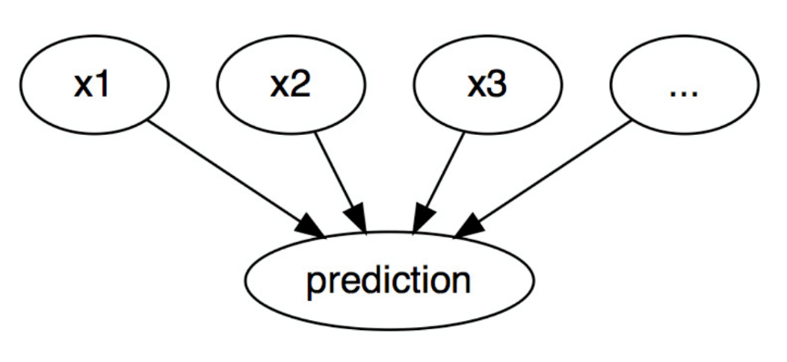
Counterfactual Explanations
Events – predicted outcome of an instance
Causes – particular feature values of this instance that were input to the model and caused a certain prediction

Slide 24
Counterfactual Explanations
Change the feature values before making a prediction and analyze how the prediction changes
Model-agnostic – can be applied to any machine learning model
Interested in scenarios where the prediction changes significantly (e.g., loan application decision being reversed)
A counterfactual explanation of a prediction describes the smallest change to the feature values that changes the prediction to a predefined output

Slide 25
Counterfactual Explanations
E.g., Peter applied for a loan and got rejected. He wonders why?
If Bank has allowed transparency, it could’ve used Counterfactual explanations
Changing the values of factors of Peter’s example we can tell whether the loan gets accepted if Peter had earn another 1000 dollars in income, or if he had fewer credit card defaults, etc.

